Slide 1

Smart Checkout: Retail Product Detection and Automatic Checkout
Bachelor’s Degree Programme in Informatica
AI Lab: Computer Vision – Signal Processing – Natural Language Processing
Shuang Dai (dai.2104150@studenti.uniroma1.it)
A.Y. 2025/2026
1

Slide 2


Table of Contents
Context
Problem and Motivation
Related Work and Gap with Respect to the State of the Art
Proposed Solution and Our Contribution
Dataset and Experimental Protocol
Critical Discussion and Limitations
Conclusion and Future Work

Slide 3

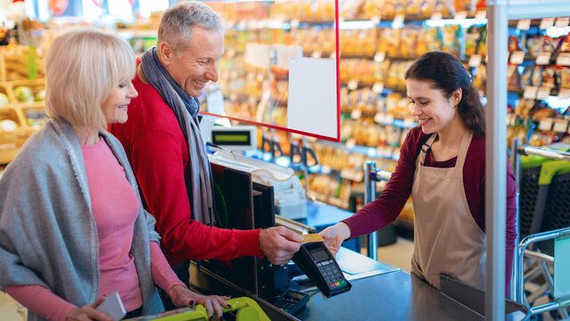
Context ●
Automatic Checkout From a Single Image
Retail Friction
Traditional barcode scanning at checkouts is slow, labor-intensive, and prone to human error, especially during peak hours.
Goal:
Given one image containing multiple products, identify every item and produce a complete checkout result.
AI Lab: Computer Vision – Signal Processing – Natural Language Processing

Slide 4
Table of Contents
Context
Problem and Motivation
Related Work and Gap with Respect to the State of the Art
Proposed Solution and Our Contribution
Dataset and Experimental Protocol
Critical Discussion and Limitations
Conclusion and Future Work

Slide 5
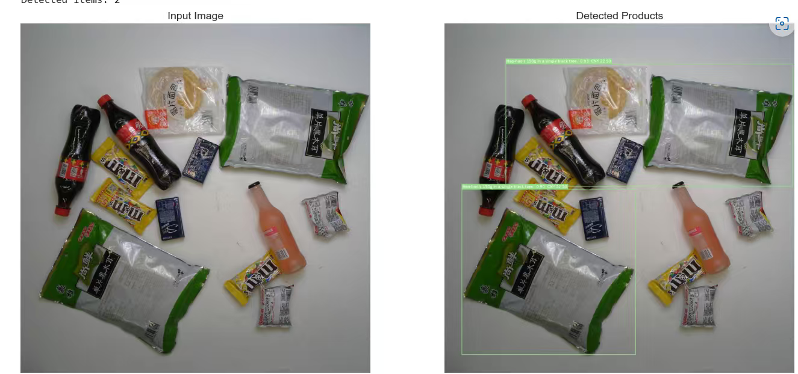
Problem and Motivation ●○
Challenges in Automatic Checkout
Multiple products in one Image
The scene may contain many instances, including repeated products and small occluded objects.
Detection errors affect the receipt
A missed or extra detection changes the quantity and therefor the final price.
End-to-end correctness matters
High mAP alone does not guarantee that an entire basket is correctly checked out.
AI Lab: Computer Vision – Signal Processing – Natural Language Processing

Slide 6
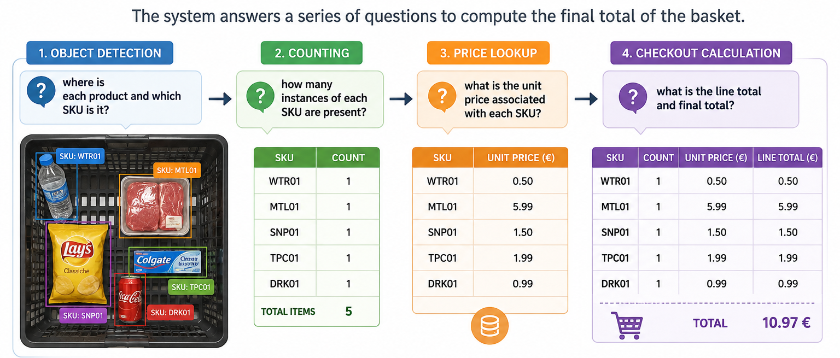
Problem and Motivation ○●
From Detection to Checkout
AI Lab: Computer Vision – Signal Processing – Natural Language Processing
Notes:
Object detection answers:
where is each product and which SKU is it?
• Counting answers:
how many instances of each SKU are present?
• Price lookup answers:
what is the unit price associated with each SKU?
• Checkout calculation answers:
what is the line total and final total?
Therefore, the project evaluates both detection quality and strict basket-level correctness.

Slide 7
Table of Contents
Context
Problem and Motivation
Related Work and Gap with Respect to the State of the Art
Proposed Solution and Our Contribution
Dataset and Experimental Protocol
Critical Discussion and Limitations
Conclusion and Future Work

Slide 8
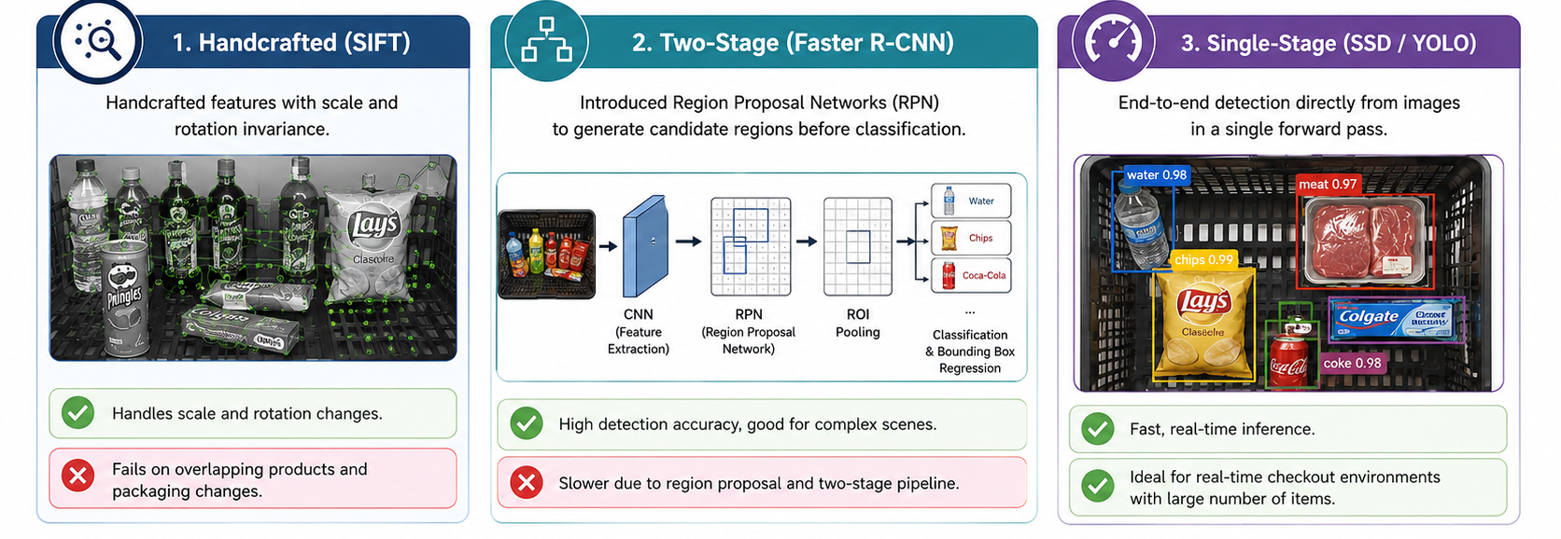
Related Work and Gap with Respect to the State of the Art ●○
Related Work
AI Lab: Computer Vision – Signal Processing – Natural Language Processing
Notes:
Handcrafted (SIFT): Handled scale/rotation, but failed on overlapping products and packaging changes.
Two-Stage (Faster R-CNN): Introduced Region Proposal Networks for high accuracy.
Single-Stage (SSD / YOLO): End-to-end detection directly from images; ideal
for real-time checkout speed.

Slide 9

Related Work and Gap with Respect to the State of the Art ○●
Gap: Detection Is Not the Final Checkout Decision
• Many object-detection pipelines stop after bounding boxes and class labels.
• A checkout system must additionally aggregate repeated SKU detections.
• The recognized SKU must be mapped to a unit price before the amount can be calculated.
• We therefore report strict checkout accuracy (cAcc) in addition to Precision, Recall, and mAP.
• The contribution is an end-to-end image-to-receipt workflow using a standard YOLO detector plus deterministic post-processing.
AI Lab: Computer Vision – Signal Processing – Natural Language Processing

Slide 10
Table of Contents
Context
Problem and Motivation
Related Work and Gap with Respect to the State of the Art
Proposed Solution and Our Contribution
Dataset and Experimental Protocol
Critical Discussion and Limitations
Conclusion and Future Work

Slide 11
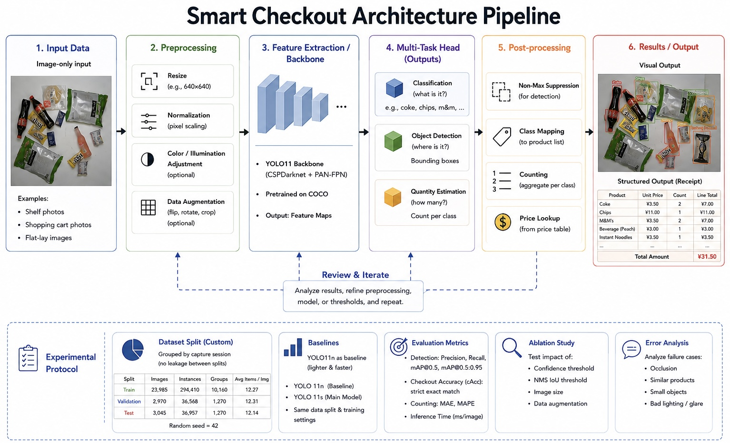
Proposed Solution and Our Contribution ●○
A Vision-Based Pipeline
AI Lab: Computer Vision – Signal Processing – Natural Language Processing

Slide 12
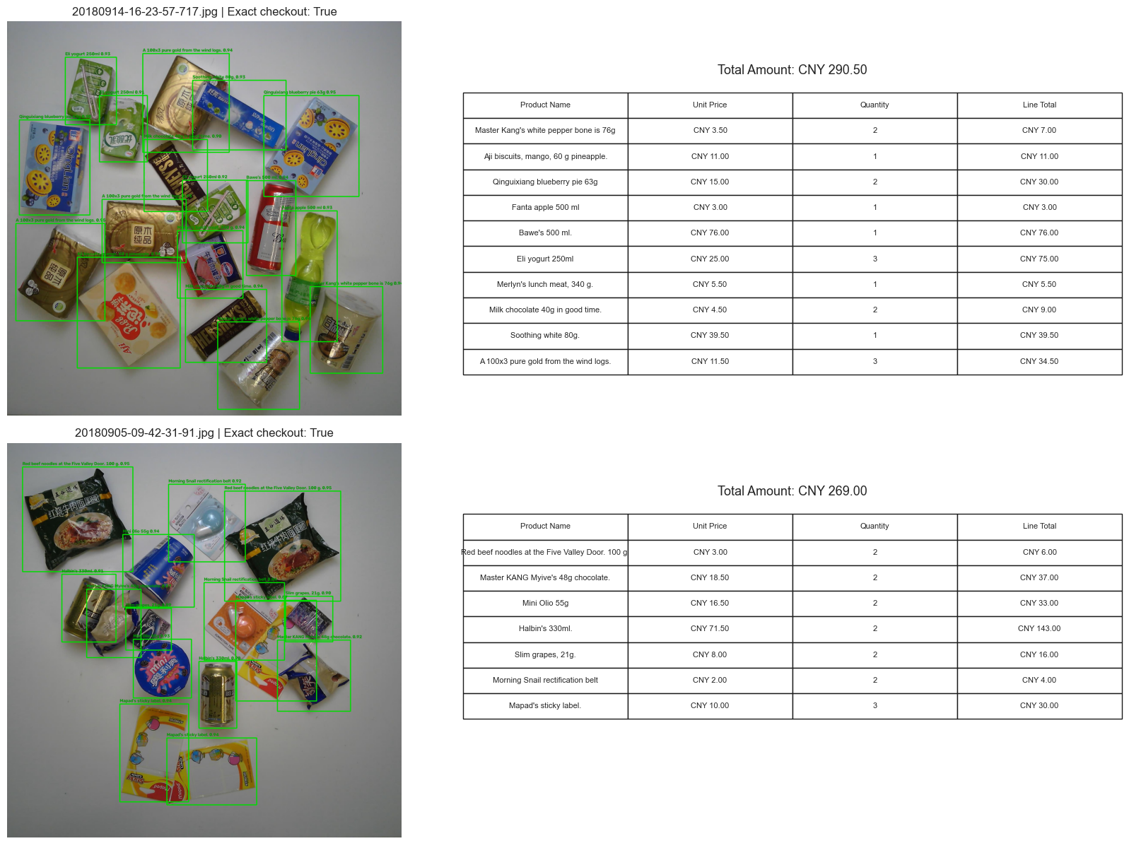
Proposed Solution and Our Contribution ○●
Detection, Counting, and Price Calculation
1. YOLO11 detection
Outputs bounding boxes and SKU class labels for the 200-product vocabulary.
2. SKU aggregation
Group detections by SKU and count repeated instances.
3. Price lookup
Map each SKU to its simulated unit price.
4. Line total
Line total = unit price × quantity.
5. Final total
Total amount = sum of all line totals.
6. Output
Annotated image + checkout table + total amount.
AI Lab: Computer Vision – Signal Processing – Natural Language Processing

Slide 13
Table of Contents
Context
Problem and Motivation
Related Work and Gap with Respect to the State of the Art
Proposed Solution and Our Contribution
Dataset and Experimental Protocol
Critical Discussion and Limitations
Conclusion and Future Work

Slide 14
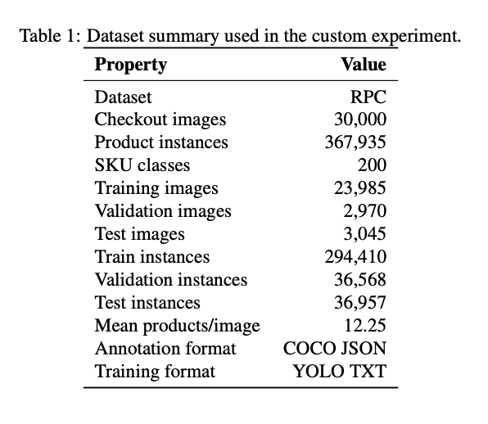
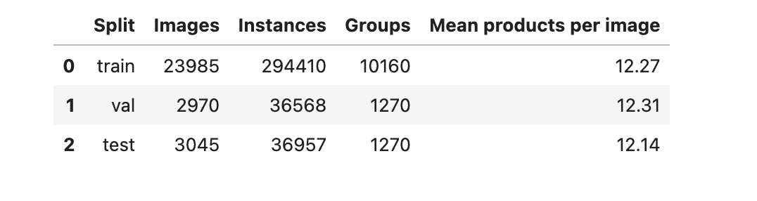
Dataset and Experimental Protocol ●○
Dataset Overview & Custom Splitting
Original Dataset: 83,739 images across 200 fine-grained SKU classes (53,739 single-product exemplars, 6,000 multi-product validation, and 24,000 multi-product test images).
Experiment Focus: Combines all multi-product checkout scenes (validation + test) into a 30,000-image dataset containing 367,935 product instances (~12.25 products per image).
Evaluation Scope: Uses a custom split to preserve realistic multi-product density; results reflect this custom protocol rather than official RPC leaderboard scores.
Specific Grouped Dataset Split:
AI Lab: Computer Vision – Signal Processing – Natural Language Processing

Slide 15
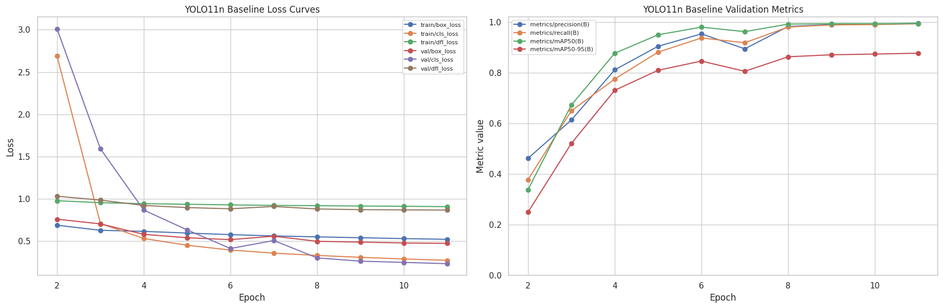
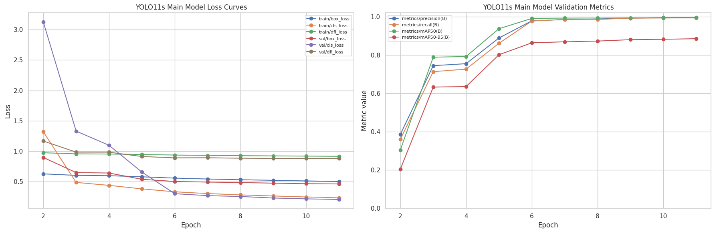
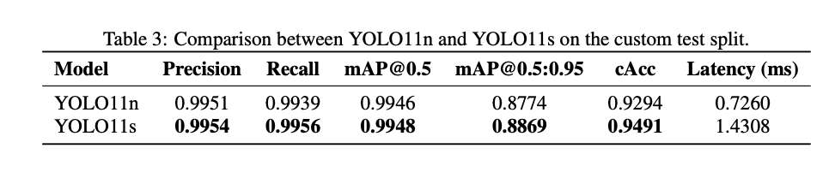
Dataset and Experimental Protocol ○●
Baseline, Main Model, and Evaluation Protocol
Baseline: YOLO11n
2,677,888 parameters • 6.9 GFLOPs • baseline detector
Main model: YOLO11s
9,490,200 parameters • 21.8 GFLOPs • used for final checkout
AI Lab: Computer Vision – Signal Processing – Natural Language Processing

Slide 16
Table of Contents
Context
Problem and Motivation
Related Work and Gap with Respect to the State of the Art
Proposed Solution and Our Contribution
Dataset and Experimental Protocol
Critical Discussion and Limitations
Conclusion and Future Work

Slide 17

Critical Discussion and Limitations ●
Limitations
Strict Metric vs. Standard mAP: High mAP@0.5 does not guarantee a functional checkout system; recovering exact SKU counts requires custom strict metrics like Checkout Accuracy (cAcc).
Visual Ambiguity Failure Modes: Performance degrades under heavy item occlusion, bad lighting/glare, or visually near-identical adjacent SKUs.
AI Lab: Computer Vision – Signal Processing – Natural Language Processing

Slide 18
Table of Contents
Context
Problem and Motivation
Related Work and Gap with Respect to the State of the Art
Proposed Solution and Our Contribution
Dataset and Experimental Protocol
Critical Discussion and Limitations
Conclusion and Future Work

Slide 19
Conclusion and Future Work ●
Achievement and Future Work
What was achieved
A complete single-image-to-checkout pipeline: detection → SKU counting → price lookup → total amount.
Best model
YOLO11s is the stronger model: mAP@0.5:0.95 = 0.8869 and cAcc = 0.9491.
Future work
• Improve robustness to heavy occlusion and visually similar products.
• Expand the product and price catalogue for broader retail scenarios.
• Investigate more advanced post-processing and uncertainty handling for checkout-level errors.
AI Lab: Computer Vision – Signal Processing – Natural Language Processing

Slide 20

THANK YOU FOR LISTENING!
ANY QUESTIONS?

